Slide 1
Questioning

Slide 2
Turn and talk…
Why do good readers ask questions when they read?

Slide 3
Two Types of Questions
THICK Questions
Thin Questions

Slide 4
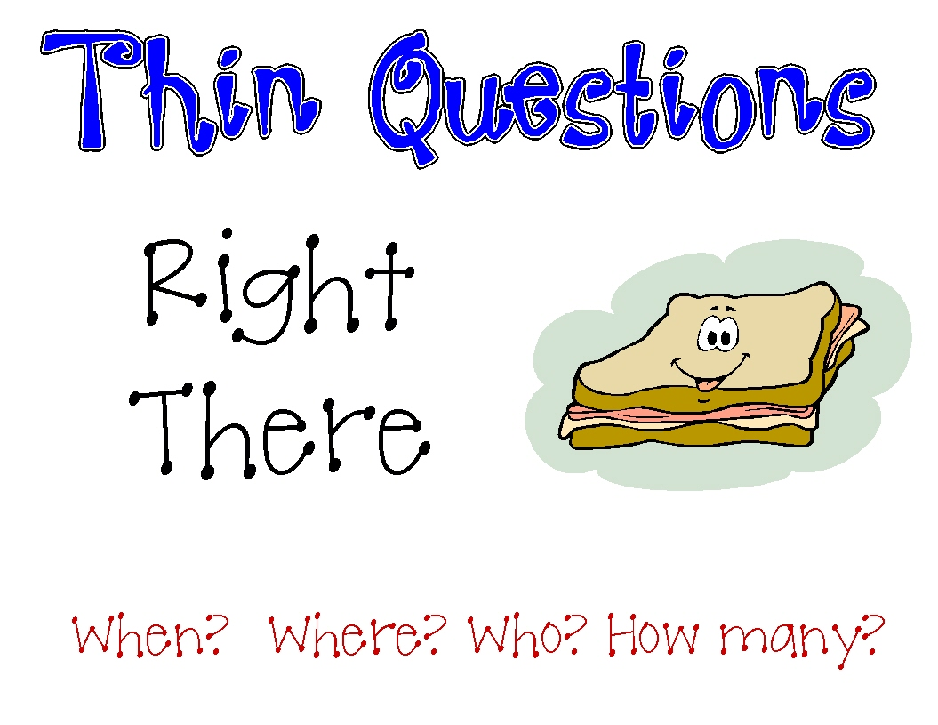

Slide 5
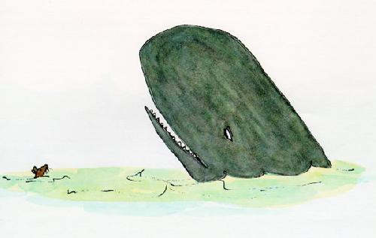
Thin Questions
Who are the main characters?
What is the setting of the story?

Slide 6
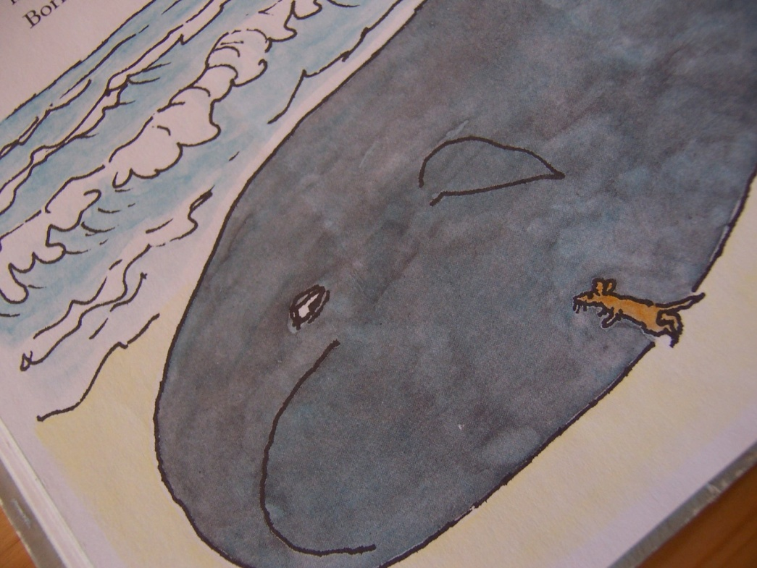
Thin Questions
Where were the characters at the end of the story?
How many problems did the characters face?

Slide 7
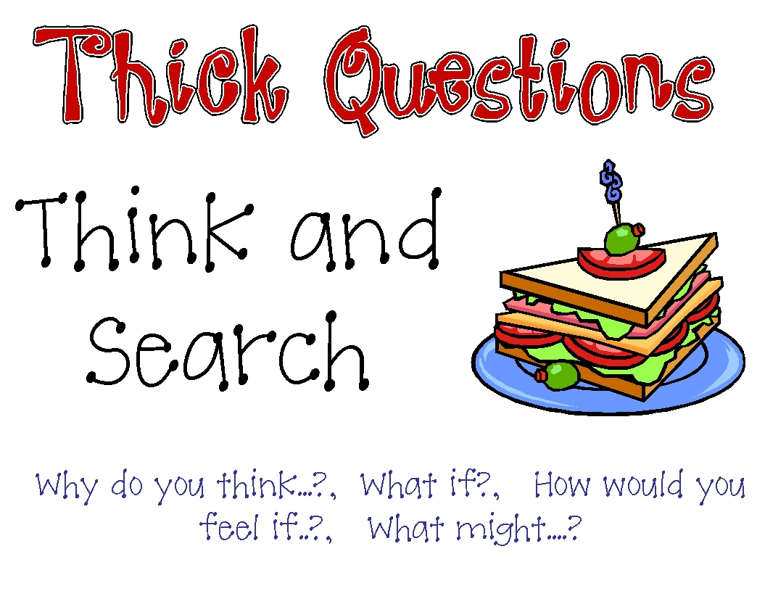

Slide 8
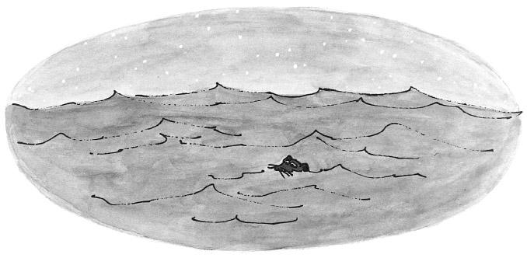
Thick Questions
What do you think the main character was feeling?
What if the problem in the story was different?

Slide 9
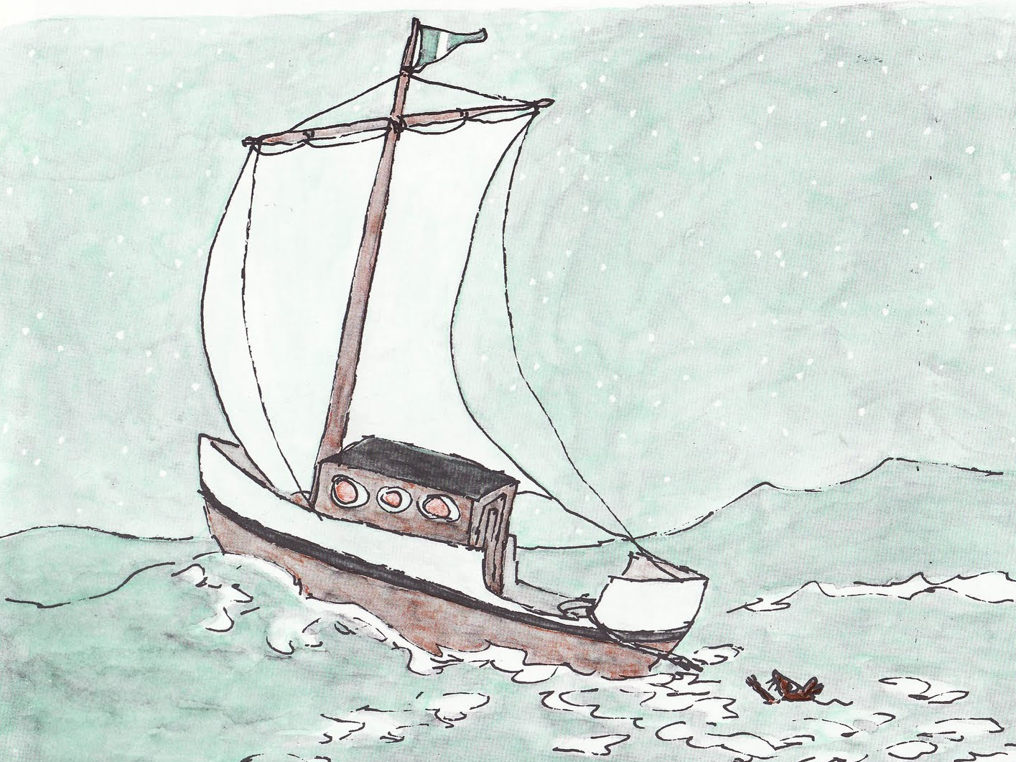
Thick Questions
What might happen if the problem was not solved?
How would you feel if you were in the story?

Slide 10
Turn and talk…
Ask your partner one thin question about When Marian Sang.
Ask your partner one THICK question about When Marian Sang.

